Slide 1
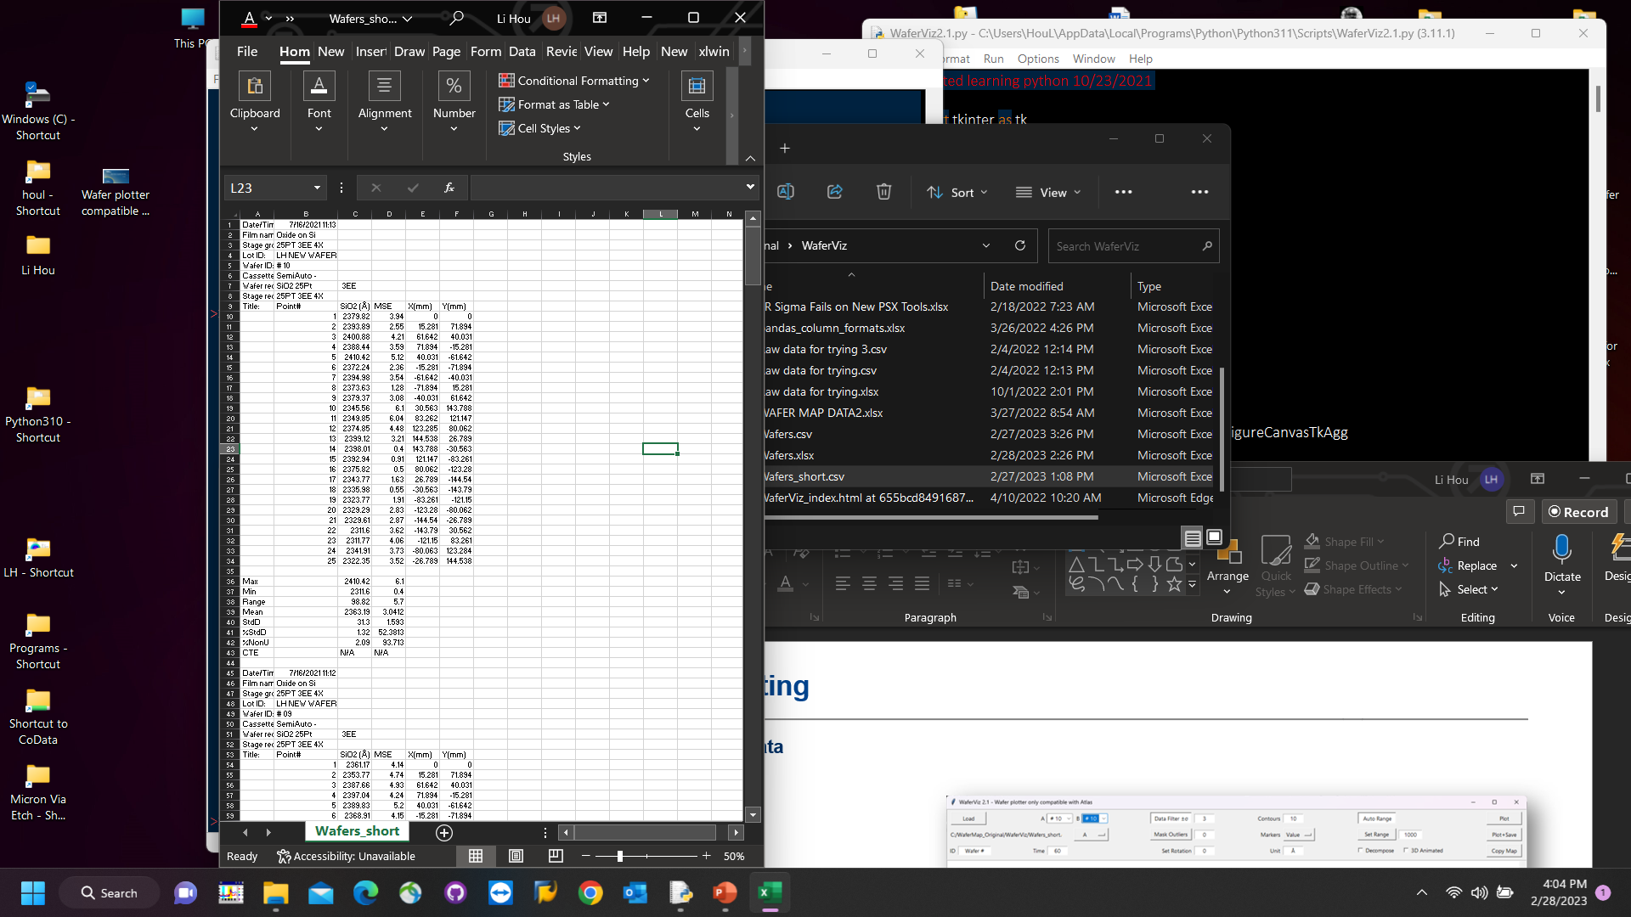
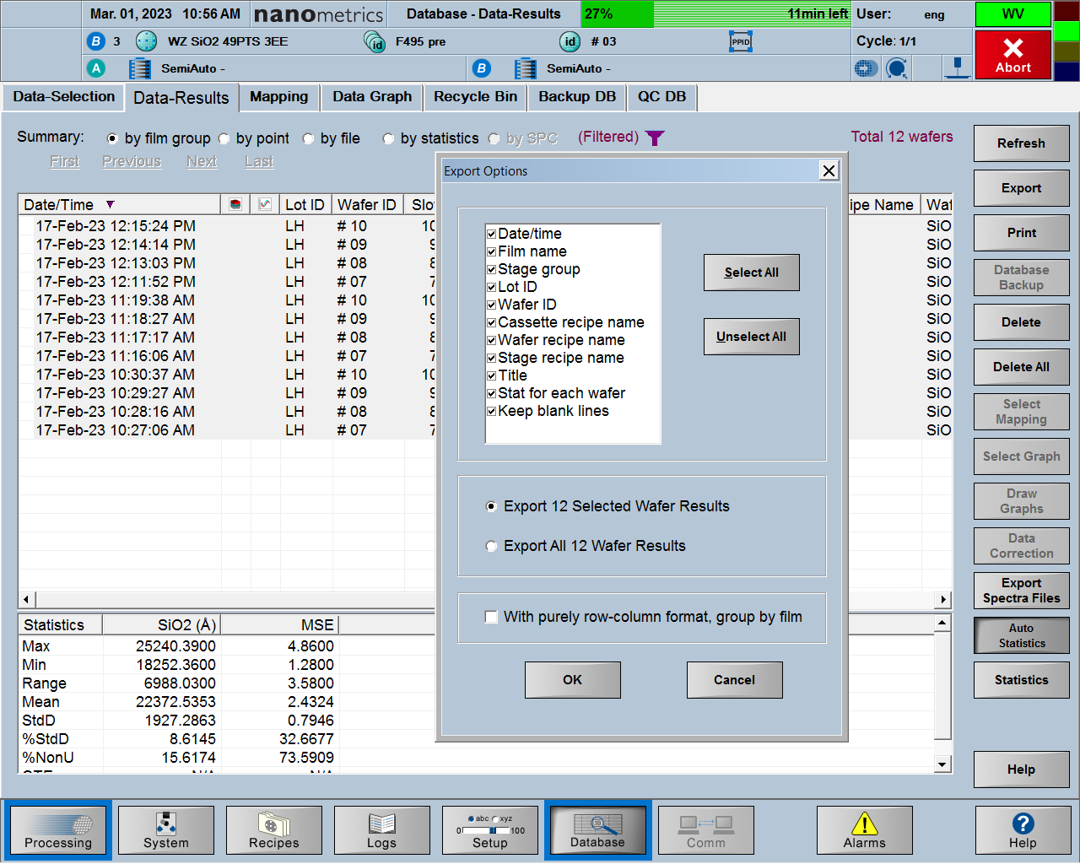
Step1: Export Atlas data.
Click “Select All” button in Atlas UI.
Keep exported file unaltered.
Either .csv or .xlsx works.

Slide 2
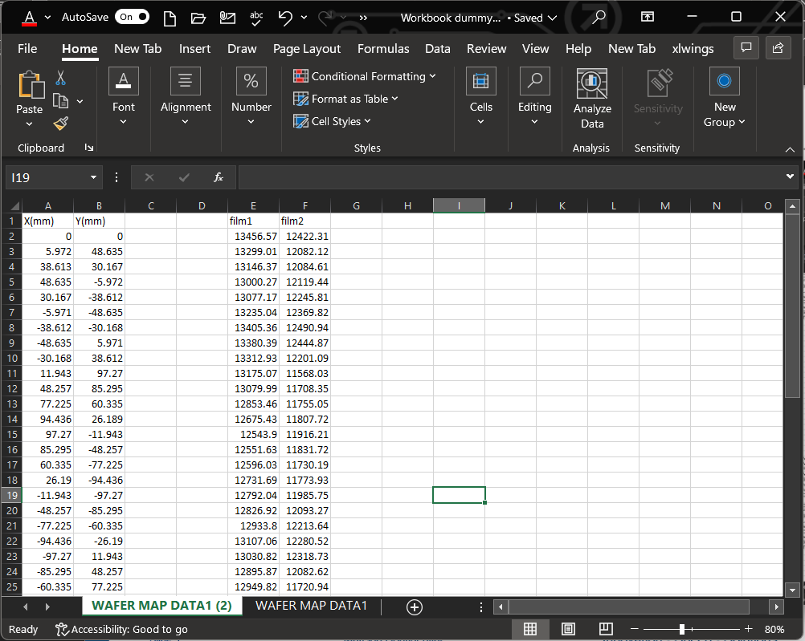
Or Preparing Workbook.
Copy/Paste Raw Data into Workbook.
Either .csv or .xlsx works.

Slide 3
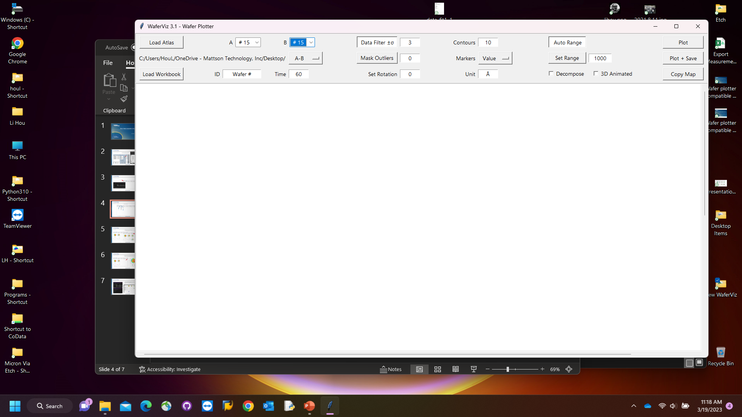
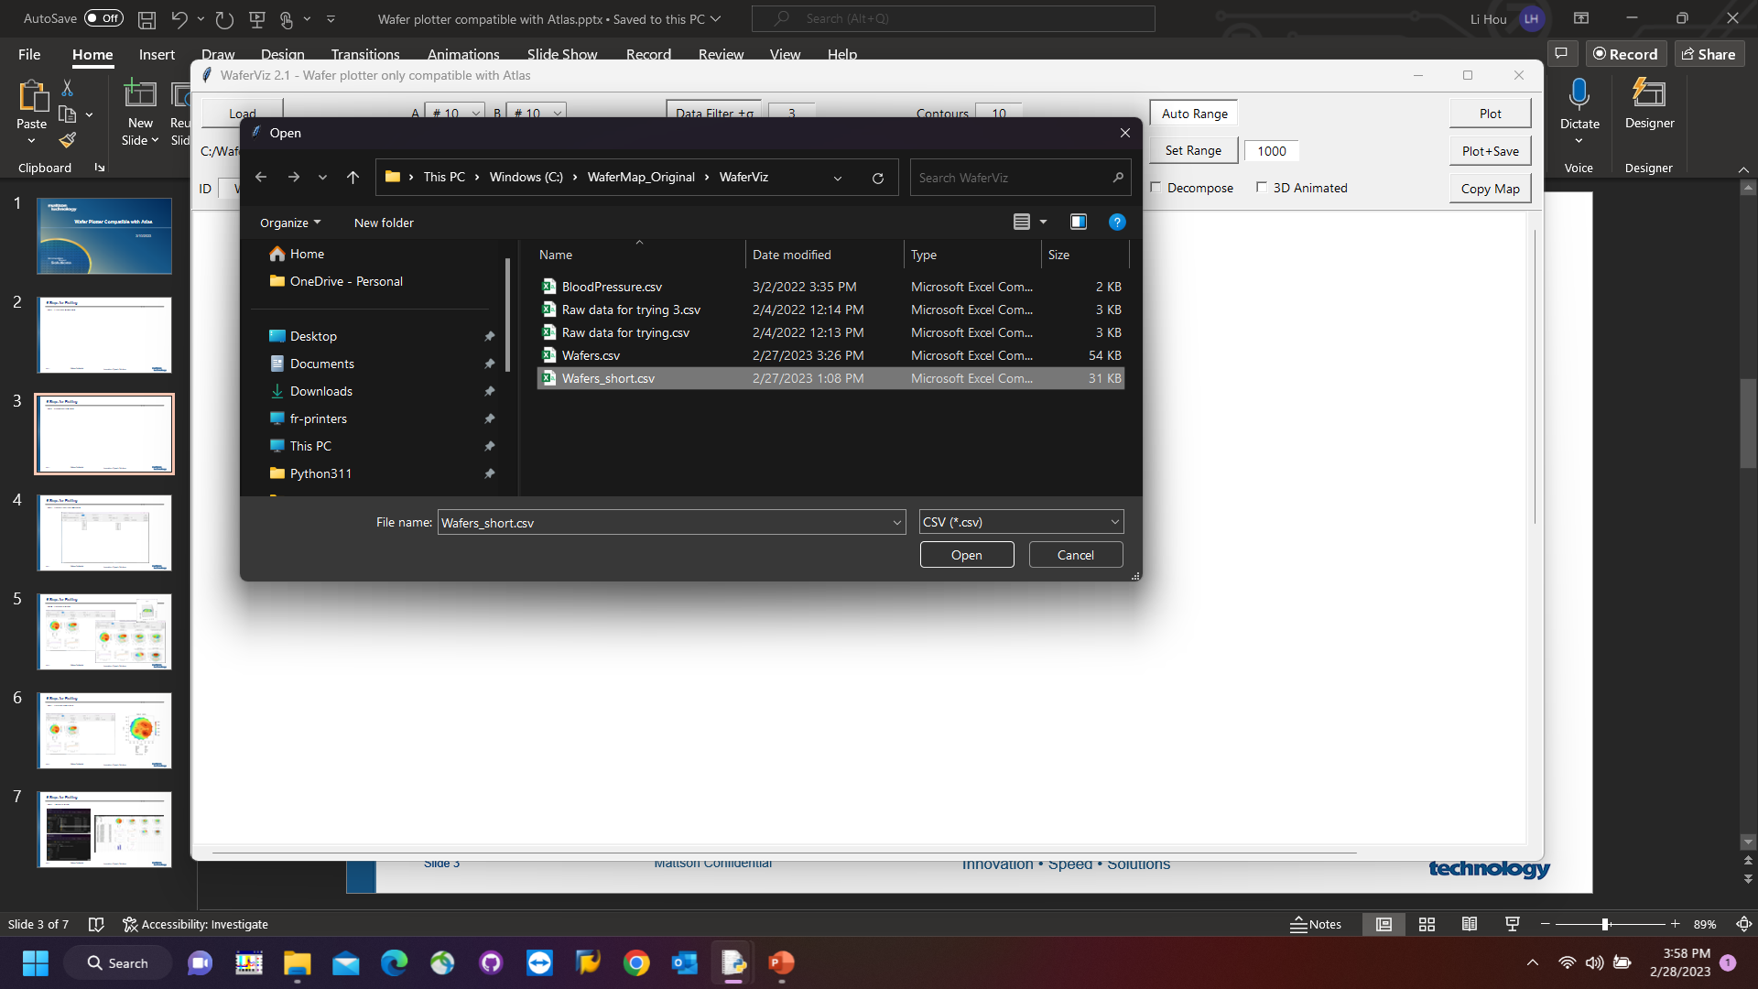

Step2: Upload the data.
Load either Atlas Data or Workbook.

Slide 4
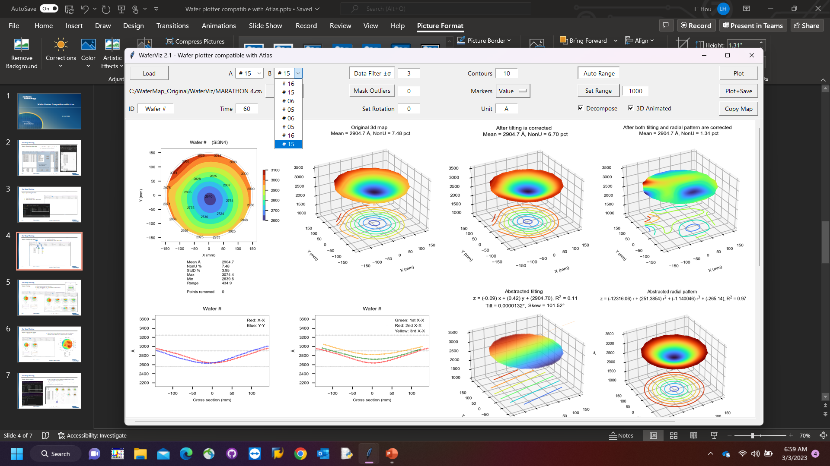
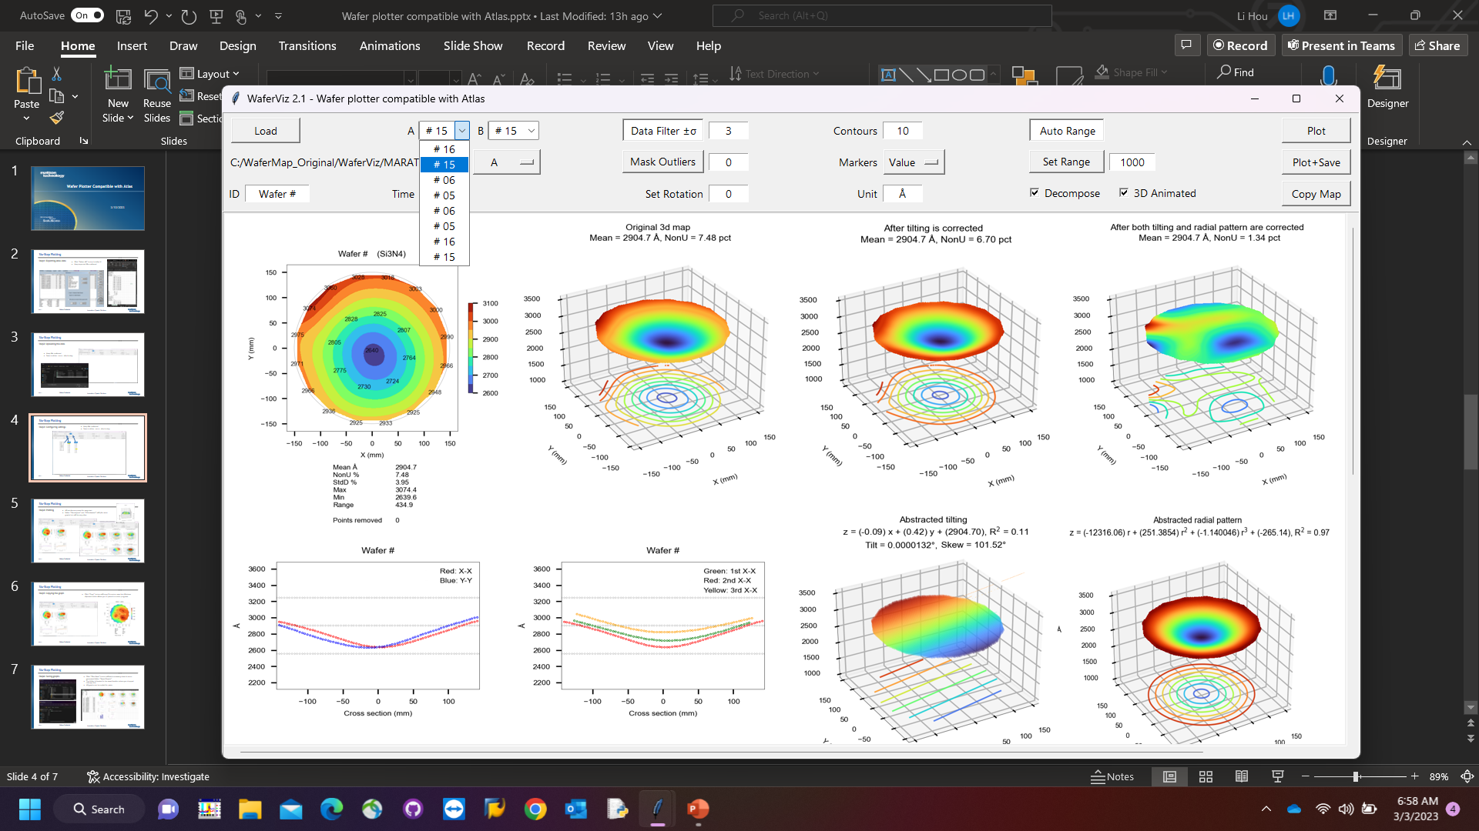
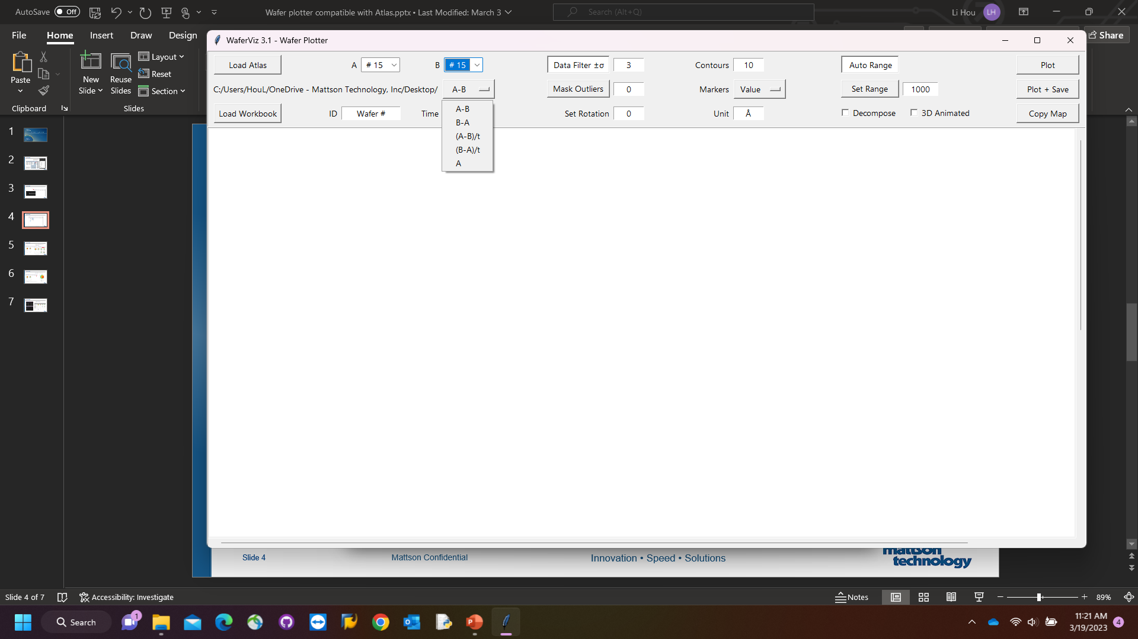
Step3: Select two films.
A for pre-, B for post-.

Slide 5
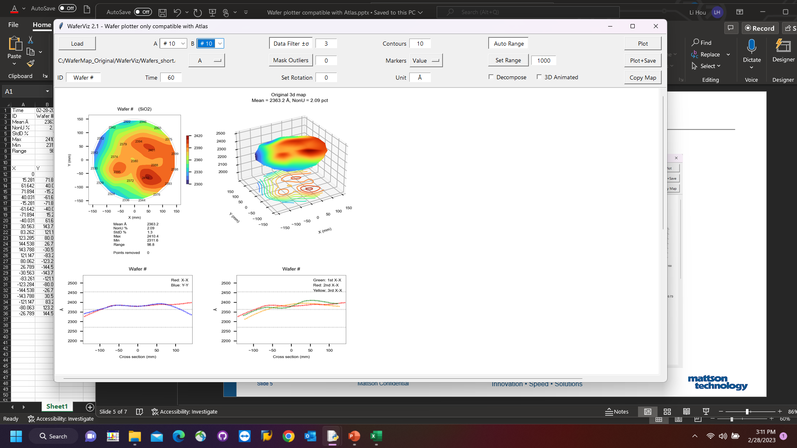
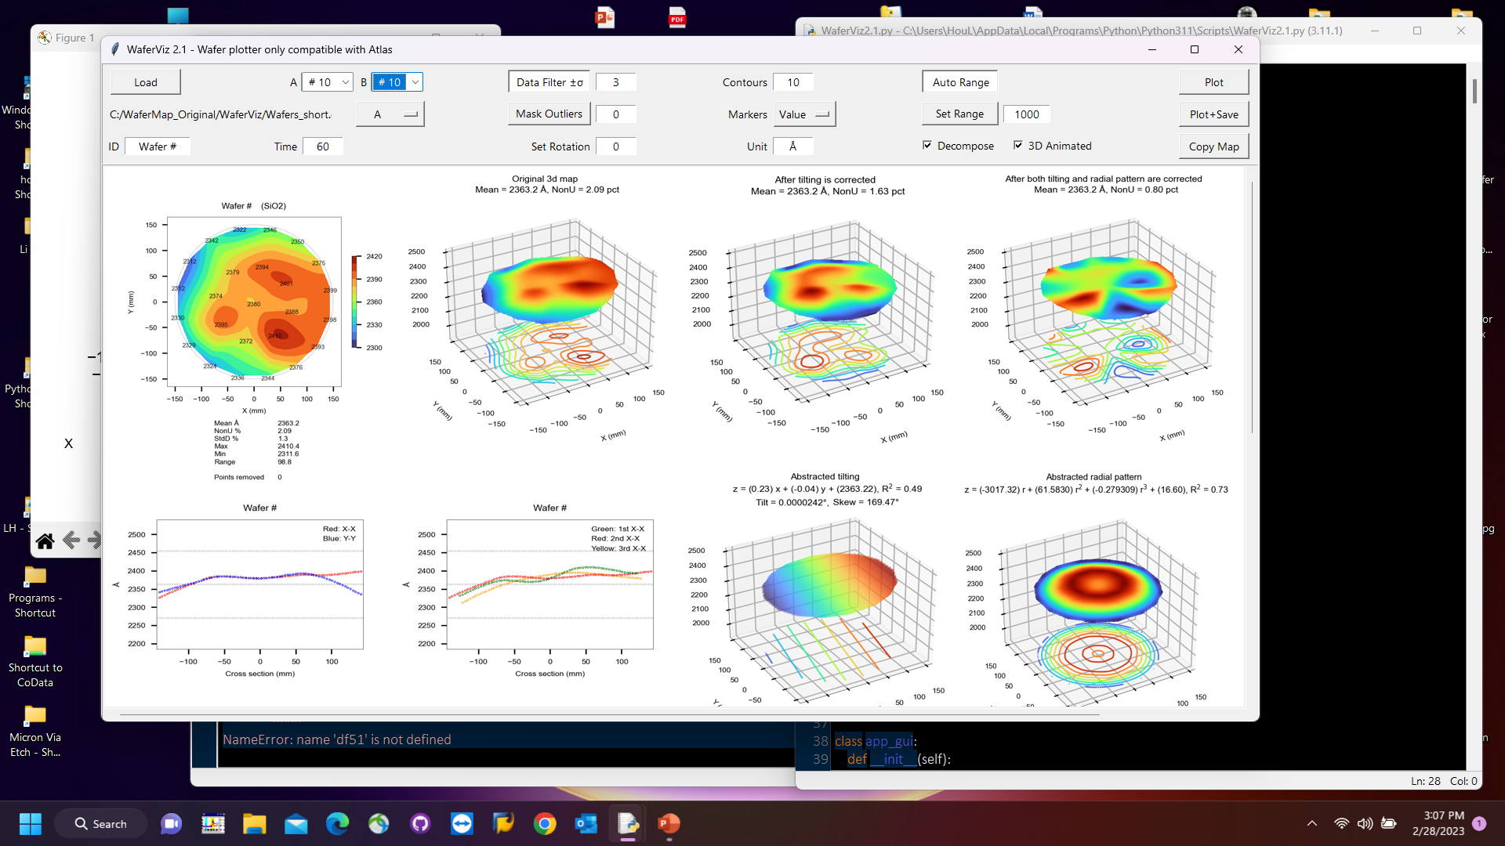
Step4: Plot.
All entries are preset for easy start.
Selecting “Decompose” and “3D Animated” plots more but slows down greatly.

Slide 6
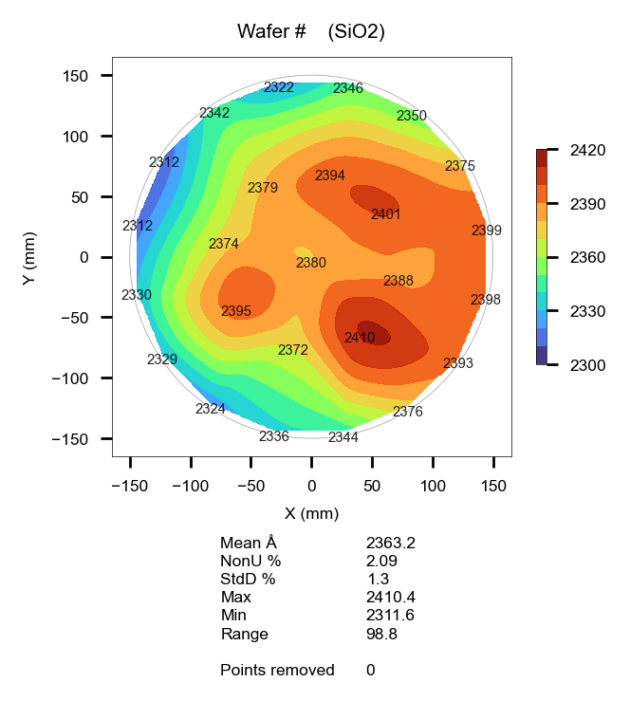

Step5: Copy the graph
Clicking “Copy” button copies contour map into Windows’. clipboard which allows you to paste it to other apps.

Slide 7
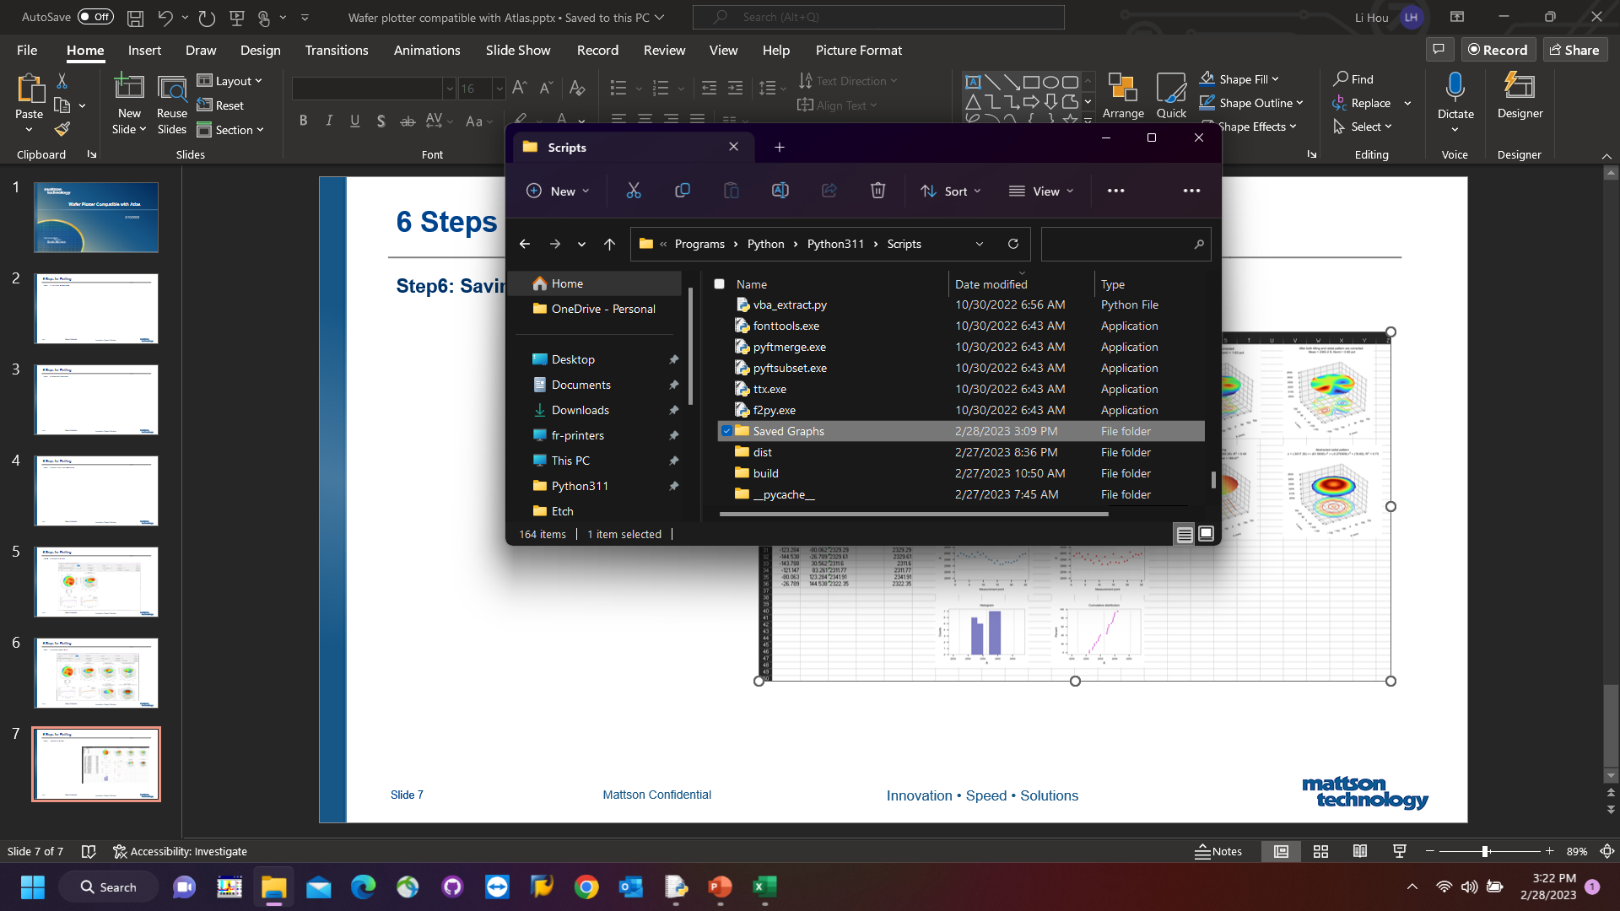
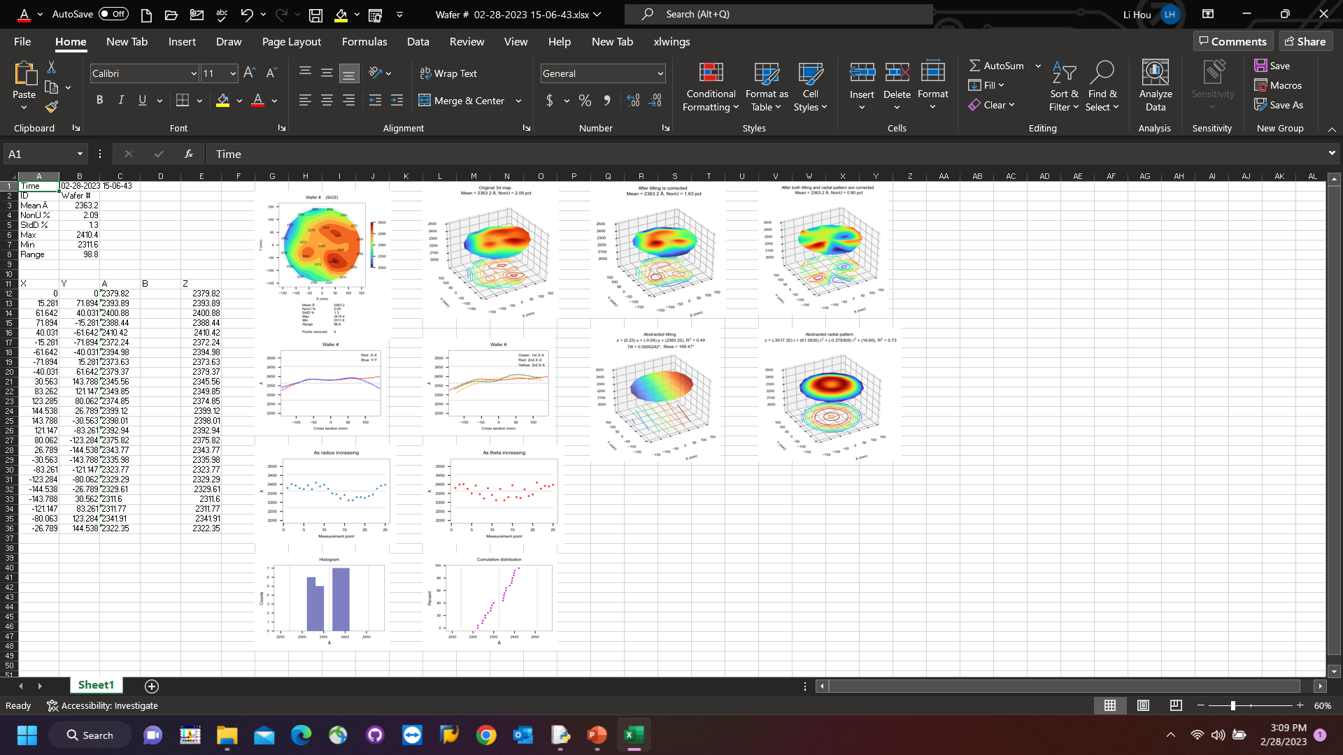
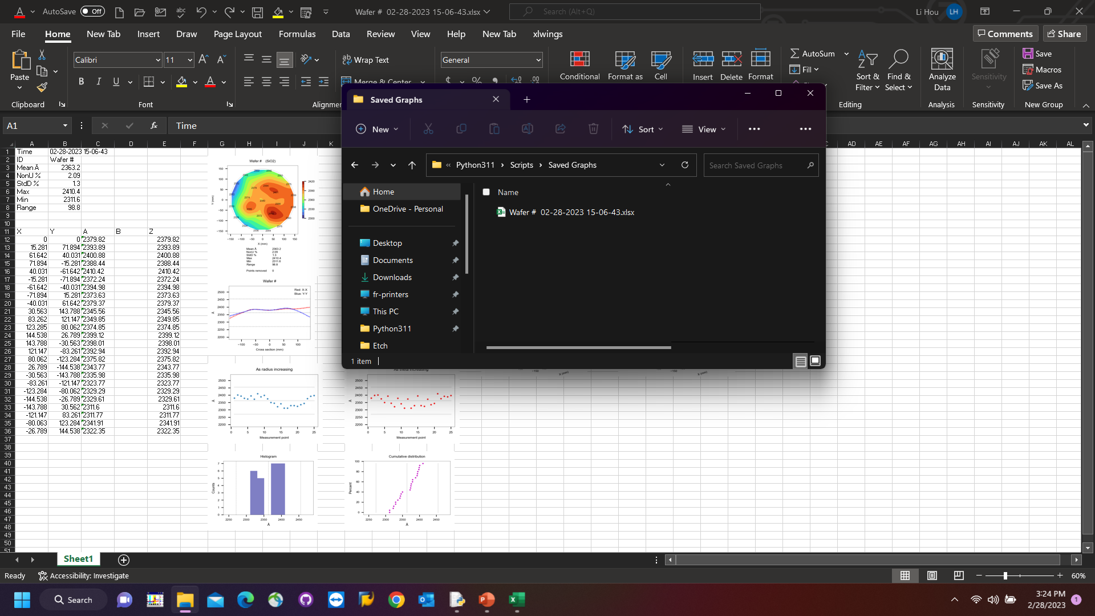
Step6: Save.
Clicking “Plot+Save” button adds a summary sheet in auto-generated folder “Saved Graphs”.
The folder is in the same location where you dropped this app into.

